Slide 1
Airbnb Case Study
Airbnb Post-Pandemic Strategy: Data-Driven Insights
Technical Analysis for Revenue Growth
Team Members
Sonal Khot
Amruta Patil
Abhinandan Gupta

Slide 2
Introduction & Business Context
Background:
• Airbnb has seen a decline in revenue during the pandemic.
• With restrictions lifting, the business needs to prepare for increased demand.
• This analysis will focus on identifying key actions Airbnb can take to boost revenue.
• The focus will be on hosts, customers, neighbourhoods, pricing, and properties.
Objective:
Provide clear, actionable insights that can be leveraged by data teams to support decision-making and optimize Airbnb’s strategy in the NYC market.

Slide 3
Purpose of the Analysis:
To perform a comprehensive data-driven analysis of Airbnb listings in New York City, focusing on Key insights on host acquisition and retention based on listing performance.
Pricing strategies aligned with customer preferences and neighborhood trends.
Room type and neighborhood analysis to better understand user booking behavior.

Slide 4
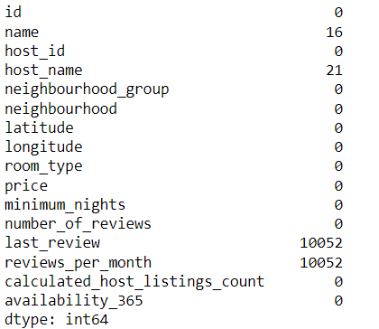
Data Cleaning and Preparation
The columns which were majorly missing in the database are Host_Name, Name of the Listing, Last Review and Reviews per month which we have replaced with NA “ Not Available”
While some reviews and the number of nights seem to vague we didn’t change the same

Slide 5
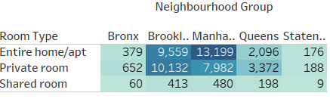
Overview of NYC Airbnb Listings
This Data of Airbnb contains a total 48,985 listings with 16 heading
The data contains 5 Neighbourhood Groups – Bronx, Brooklyn, Manhattan, Queens, and Staten Island while there are 221 unique neighbourhood
3 Room Types – Entire Home /apt, Private Room, Shared Room
The Average price for overall starts from 51$ to Max 249$
Table A
Table B – Excel Worksheet
Appendix Created the Table in Tableau (rows and Columns) and Excel (Pivot function)

Slide 6
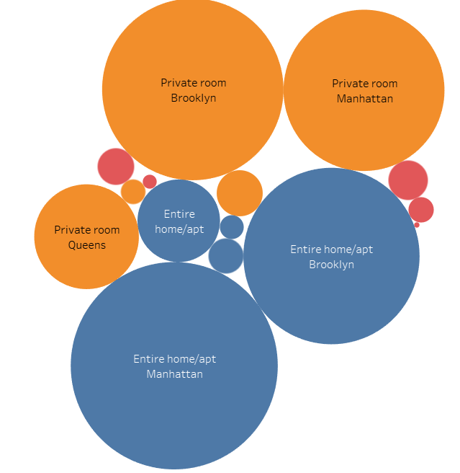
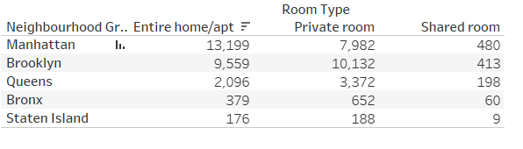
Room type Listing
The Major listing on Airbnb is done for Entire home/apt i.e. 25409 while Private room are the second in listing
Manhattan, Brooklyn are the top 2 Neighbourhood Groups with most of the listings

Slide 7
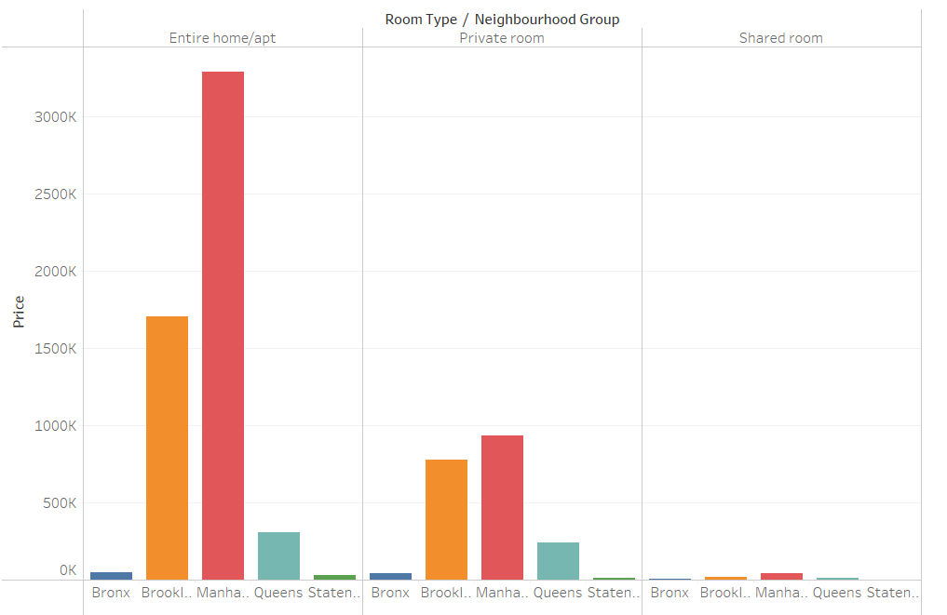
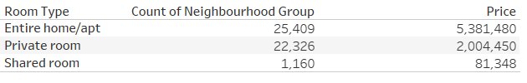
Profit and Revenue Insights
Airbnb major profits are earned from Entire Home / Apt. booking followed by private room .

Slide 8
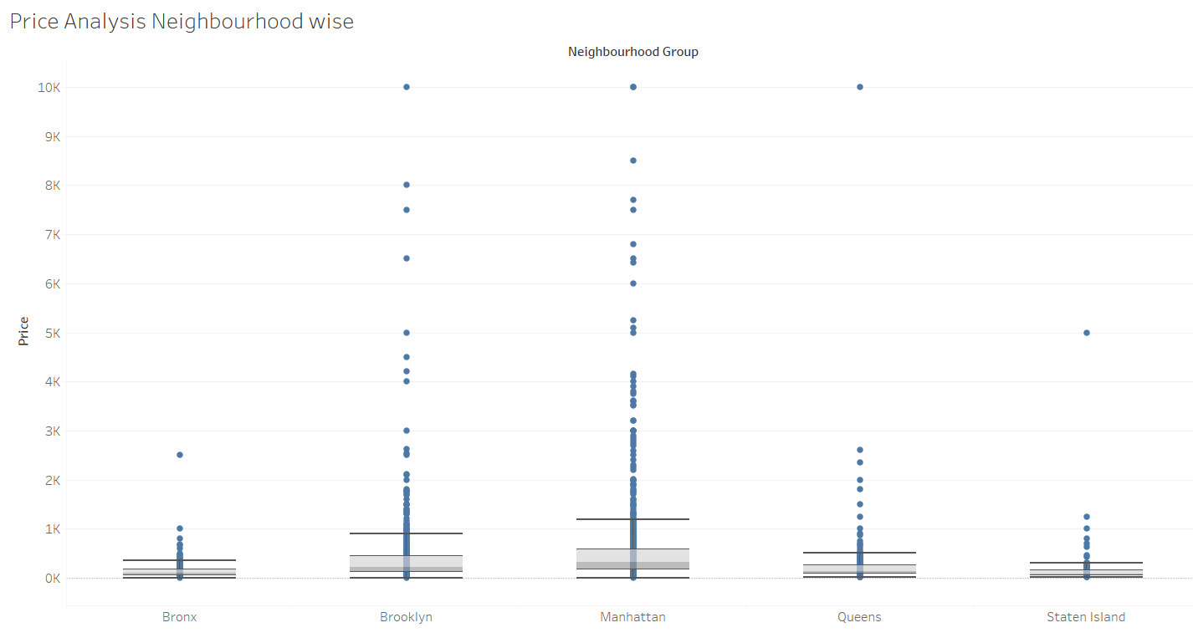
Pricing Analysis
The majority of price outliers are concentrated in Brooklyn and Manhattan.
Manhattan has the widest range of prices among all the listings.
The Bronx is the most affordable neighborhood overall.
The median prices for all neighborhood groups fall between $80 and $300.
Prices show a strong positive skew, with the median positioned near the lower quartile, and some notable outliers, as indicated in the boxplot below.

Slide 9
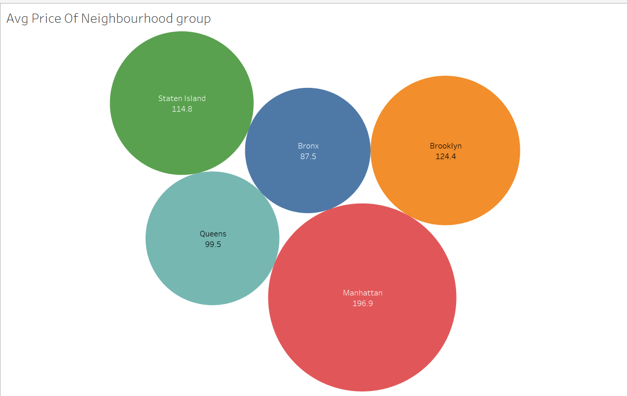
Average Price of Neighbourhood
Manhattan has the highest average property listing price at $196.9, followed by Brooklyn at $124.4.
The Bronx stands out as a more affordable option, with an average price nearly half that of Manhattan.

Slide 10
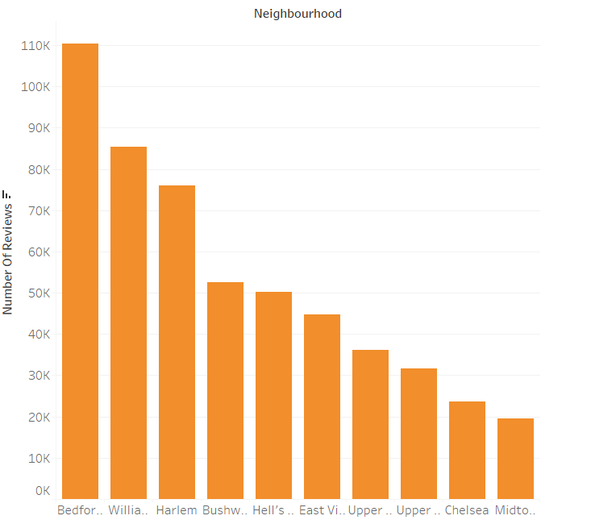
Popularity of Localities and Properties
Bedford-Stuyvesant in Brooklyn leads in popularity with a total of 110,352 reviews, followed by Williamsburg. In Manhattan, Harlem has received the highest number of reviews, followed closely by Hell’s Kitchen.

Slide 11
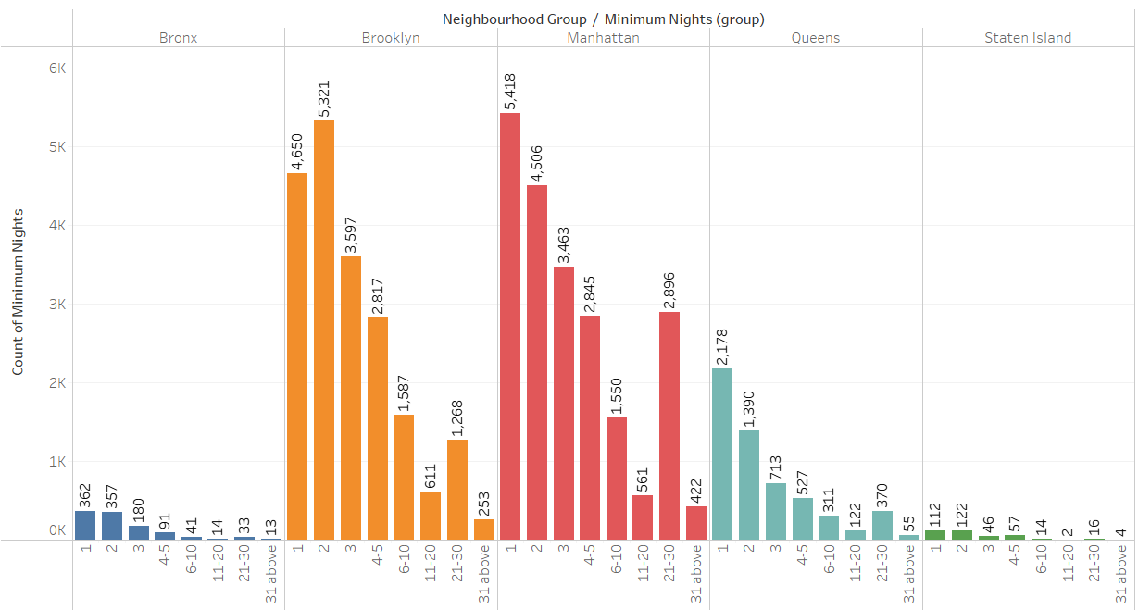
Minimum Night Insights
Majority of listing are booked for minimum 3 days
Manhattan and Brooklyn has the max nights booked

Slide 12
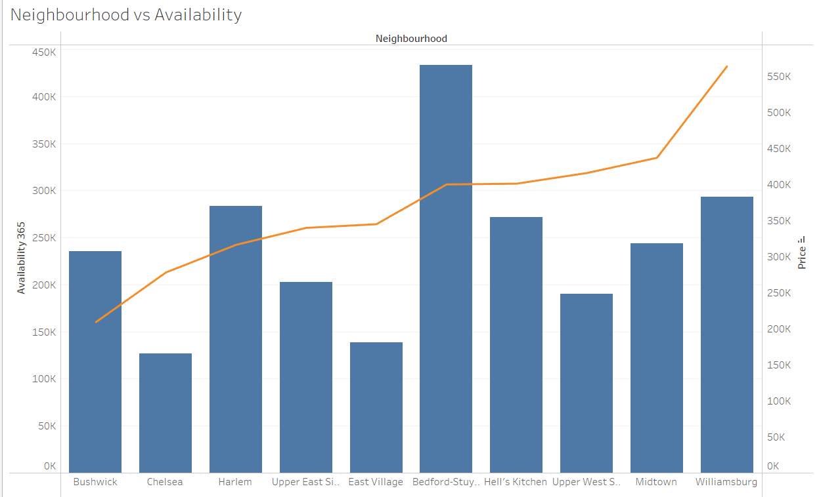
Neighbourhood vs Availability
Bedford offers the highest availability and is priced on the lower side, making it a great option for customers.
Harlem follows a similar pattern, though to a slightly lesser extent.
Chelsea, while priced higher, has limited availability.
In contrast, William is priced high with only average availability.

Slide 13
Conclusion & Key Findings
Host Insights: Entire homes in Manhattan and Brooklyn generate the most revenue and reviews.
Pricing: Mid-range pricing ($100-$200) sees higher occupancy, especially in popular neighborhoods.
Customer Preferences: Guests prefer entire homes for longer stays, while private rooms need promotions in affordable areas.
Listings in popular neighborhoods like Manhattan and Brooklyn are priced significantly higher, while less popular areas show lower demand.
There is a strong correlation between competitive pricing and occupancy rates, especially in mid-range price brackets ($100-$200).
Private rooms are more popular in affordable neighborhoods but may require promotional efforts to maintain occupancy.
High-speed Wi-Fi and flexible check-ins are top customer preferences.
Properties with fewer amenities and lower reviews underperform

Slide 14
Appendix: Methodology
Data Cleaning (Python)
Tools: Python (Pandas, NumPy)
Steps:
Missing Values: Replaced missing values in columns
like host_name and reviews_per_month with "NA" or 0.
Outlier Removal: Used interquartile range (IQR) to detect and
remove outliers in fields like price and minimum_nights.
Data Formatting: Standardized date fields and normalized text.

Slide 15
2. Insights & Visualization (Tableau & Excel)
Tools: Tableau
Steps:
Imported the cleaned dataset into Tableau.
Overview of NYC Airbnb Listing – created table by adding the Room type and Neighbourhood in Rows and Columns while considered total count for value in table A in tableau and Average of the Prices in Table B for Value in Excel Worksheet
Room Type listing Added Room type in Rows and Neighbouhood in Columns with the Count of the listing as value and selected packed bubble for Visualization
Profit and Revenue insights – we used side by side bars with text table to compare neighbourhoods as per room type to find the highest revenue generato
Pricing Analysis - We used a box and whisker’s plot with Neighbourhood Groups in Columns and Price in Rows. We changed the Price from a Sum Measure to the median measure.
Average Price of Neighbourhood - We created a bubble chart with Neighbourhood Groups in Columns and Price column in Rows.

Slide 16
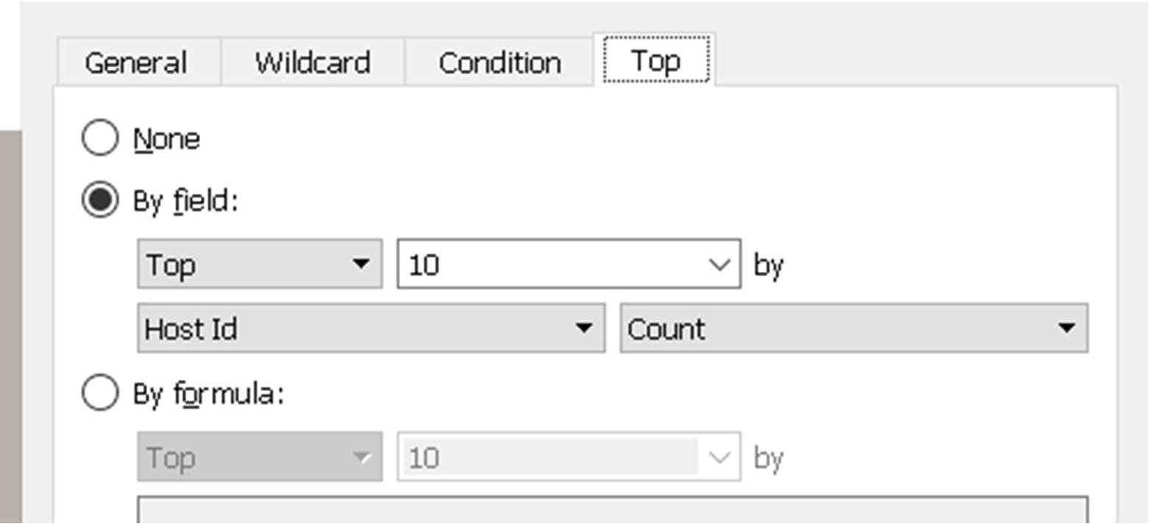
6.Popularity of Localities and Properties – We created bar chart and sorted it to highlight the top 10 best performing neighbourhood and filter top 10 in given way
7. Minimum Night Insights – Created Groups for the Night by Right click to click option > Create > group then added the required numbers in a group and applied the same.
8. Neighbourhood vs Availability - We created a dual axis chart using bar chart for availability 365 and line chart for price for top 10 neighbourhood group sorted by price.

Slide 17
Thank You

